Slide 1
Flight Delay and Cancelation
Božidar Vladislav

Slide 2
Dataset Information
The main dataset contains 5 819 079 entries of flights in the US, attributes of data are airlines, origin airport, destination airport, departure delay, arrival delay…
There are two more datasets that contain information about airlines and airports
All data is gathered in 2015. by US Department of Transportation

Slide 3
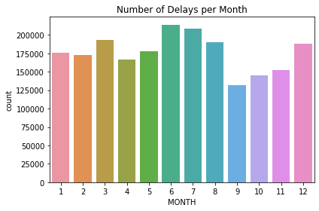
Delays per Month

Slide 4
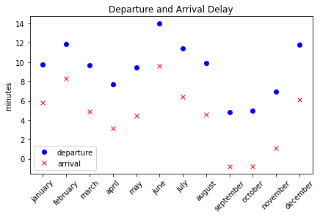
Departure and Arrival Delay
Difference between departure and arrival delay is less than 5 minutes, so that would be the time airplanes compensate in the air
In this graph we see the mean value of departure and arrival delay for every moth

Slide 5
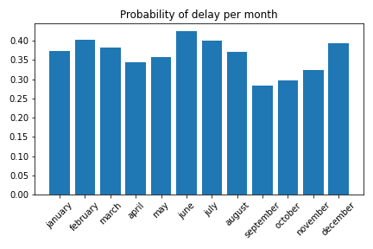
Probability of delay per month

Slide 6
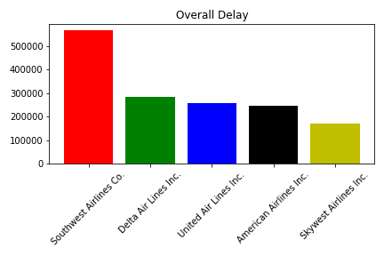
Companies with most Delays
Company with most number of delays is Southwest Airlines Co. with 566807 delays in 2015
Company with least number of delays is Hawaiian Airlines Inc. with 20146 delays

Slide 7
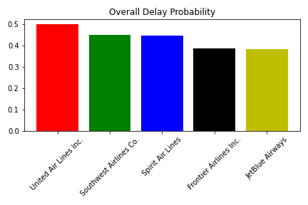
Companies with highest probability of delay
Company with lowest overall delay probability is “Alaska Airlines Inc.” with probability 0.25252577947032534

Slide 8
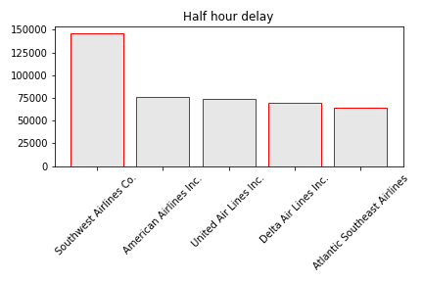
Half Hour Delay
Company with most 30+ minutes delays is Southwest Airlines Co. with 146585 delays
Company with least 30+ minutes delays is Hawaiian Airlines Inc. with 2407 delays
There is a difference between overall delays in second, forth and fifth place

Slide 9
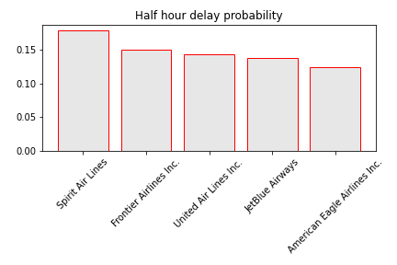
Half hour delay
Company with lowest probability of delay of more than half hour is “Hawaiian Airlines Inc.” with probability 0.031558107824627646

Slide 10
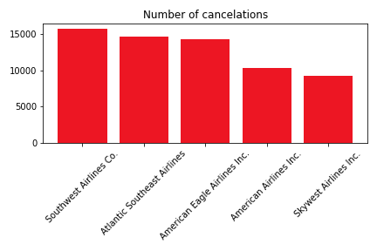
Cancelation
Airline with the highest number of canceled flights is Southwest Airlines Co. with 15726 cancelations
Airline with the lowest number of canceled flights is Hawaiian Airlines Inc. with 153 cancelations

Slide 11
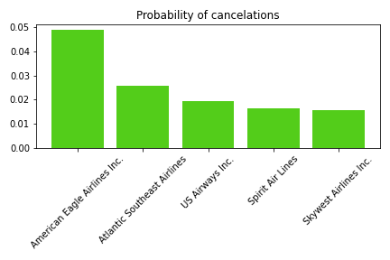
cancelation
Company with lowest probability of cancelation is “Hawaiian Airlines Inc.” with probability 0.0020059786028949022

Slide 12
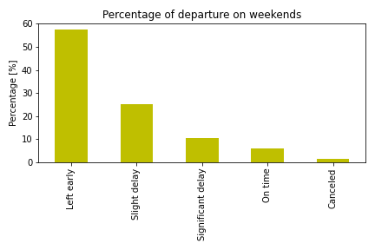
Weekend Delay
Left early 57.381007%
Slight delay (under half hour) 25.248879%
Significant delay 10.307783%
On time 5.685206%
Canceled 1.377124%

Slide 13
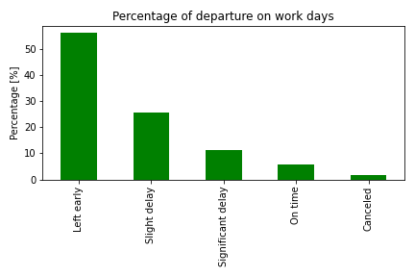
Work Day Delay
Left early 55.960375%
Slight delay (under half hour) 25.667311%
Significant delay 11.204180%
On time 5.651104%
Canceled 1.517031%

Slide 14
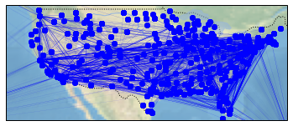
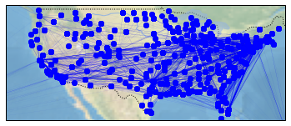
Origin-Destination Pairs Analysis
Graph of Delayed Flights (30+ min)
Graph of Canceled Flights

Slide 15
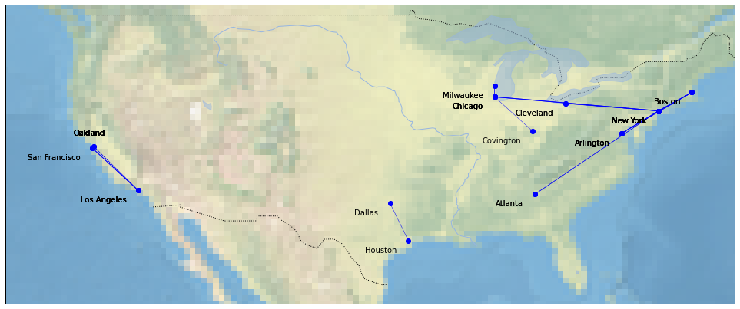
Origin-Destination Pairs Analysis (Cancelation)

Slide 16
Origin-Destination Pairs Analysis (Cancelation)
Flight from “Gen. Edward Lawrence Logan International Airport” in Boston to “LaGuardia Airport (Marine Air Terminal)” in New York is the one with the highest number of cancelation – 434
Flight from “Denver International Airport” in Denver to “Southwest Florida International Airport” in Fort Myers has been canceled only once in 2015 along with 922 others

Slide 17
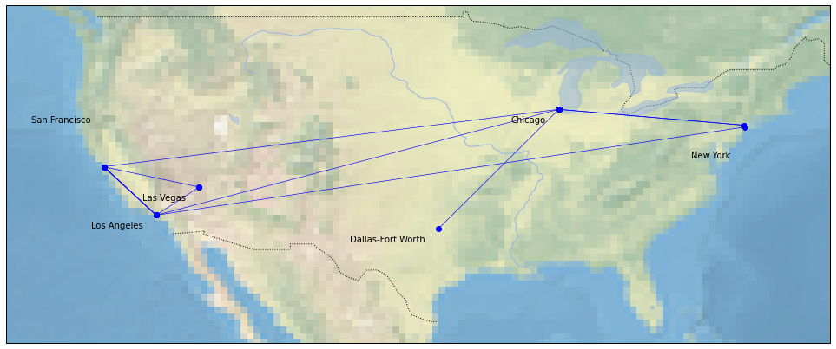
Origin-Destination Pairs Analysis(Delays)

Slide 18
Origin-Destination Pairs Analysis(Delays)
Flight with the most delays more than 30 minutes is the flight from “Los Angeles International Airport” in Los Angeles to “San Francisco International Airport” in San Francisco. It has been delayed 2160 times.
One of 498 flights that have been delayed only once in 2015. is from “Valley International Airport” in Harlingen Texas to “Laredo International Airport” in Laredo Texas

Slide 19
Thank you

